Slide 1
ANTI-THEFT FLOORING SYSTEM TARP(CSE1901) PROF. DR. GEETHA S TEAM MEMBERS 19BCE1676 – ADITYA POKHRIYAL 19BCE1690 – SHREYA AGRAWAL 19BCE1692 – SHUBHAM JINDAL 19BCE1850 – VIVEK KUMAR 19BCE1860 – NIMISHA SWAIN

Slide 2
IOT based Anti-theft Flooring
System using Raspberry Pi
Security and safety have always become a basic necessity for the urban population. With the rapid urbanization and development of big cities and towns, the graph of crimes is also on the rise. The basic anti theft security systems that use sensors on walls or motion detection sensors can be avoided by using IR blocking clothes or hiding behind objects or simply identifying and disabling them. To secure and guard our house in our absence, we propose the IOT based Anti-theft Flooring System using Raspberry Pi. This system monitors the entire floor for movement

Slide 3
One single step anywhere on the floor is tracked and user is alarmed over IOT. This system is secure flooring tile connected with IOT when we go out of house, the system is to be turned on, then whoever comes inside the house it passes the information over IOT. This system powered is by Raspberry pi it includes, two tiles for demonstration purpose, Piezo sensor, camera, wifi modem. Whenever the thief enters in the house, and steps on the floor immediately it is sensed by the sensor which passes on the signal to raspberry pi controller. The controller in turn processes it to be valid signal and then moves the camera to the area where movement was detected and then transmits it over the Internet for the home owner to check the image. We here use IOTGecko for the web based GUI of IOT system which sounds an alert and shows the image captured to user.

Slide 4
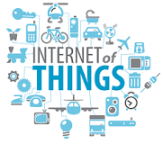
The Internet of Things (IOT), is the network of physical objects or "things" embedded with electronics, software, sensors, and network connectivity, which enables these objects to collect and exchange data.
The Internet of Things allows objects to be sensed and controlled remotely across existing network infrastructure, creating opportunities for more direct integration between the physical world and computer-based systems, and resulting in improved efficiency, accuracy and economic benefit. Each thing is uniquely identifiable through its embedded computing system but is able to interoperate within the existing Internet infrastructure. Experts estimate that the IOT will consist of almost 50 billion objects by 2020.

Slide 5
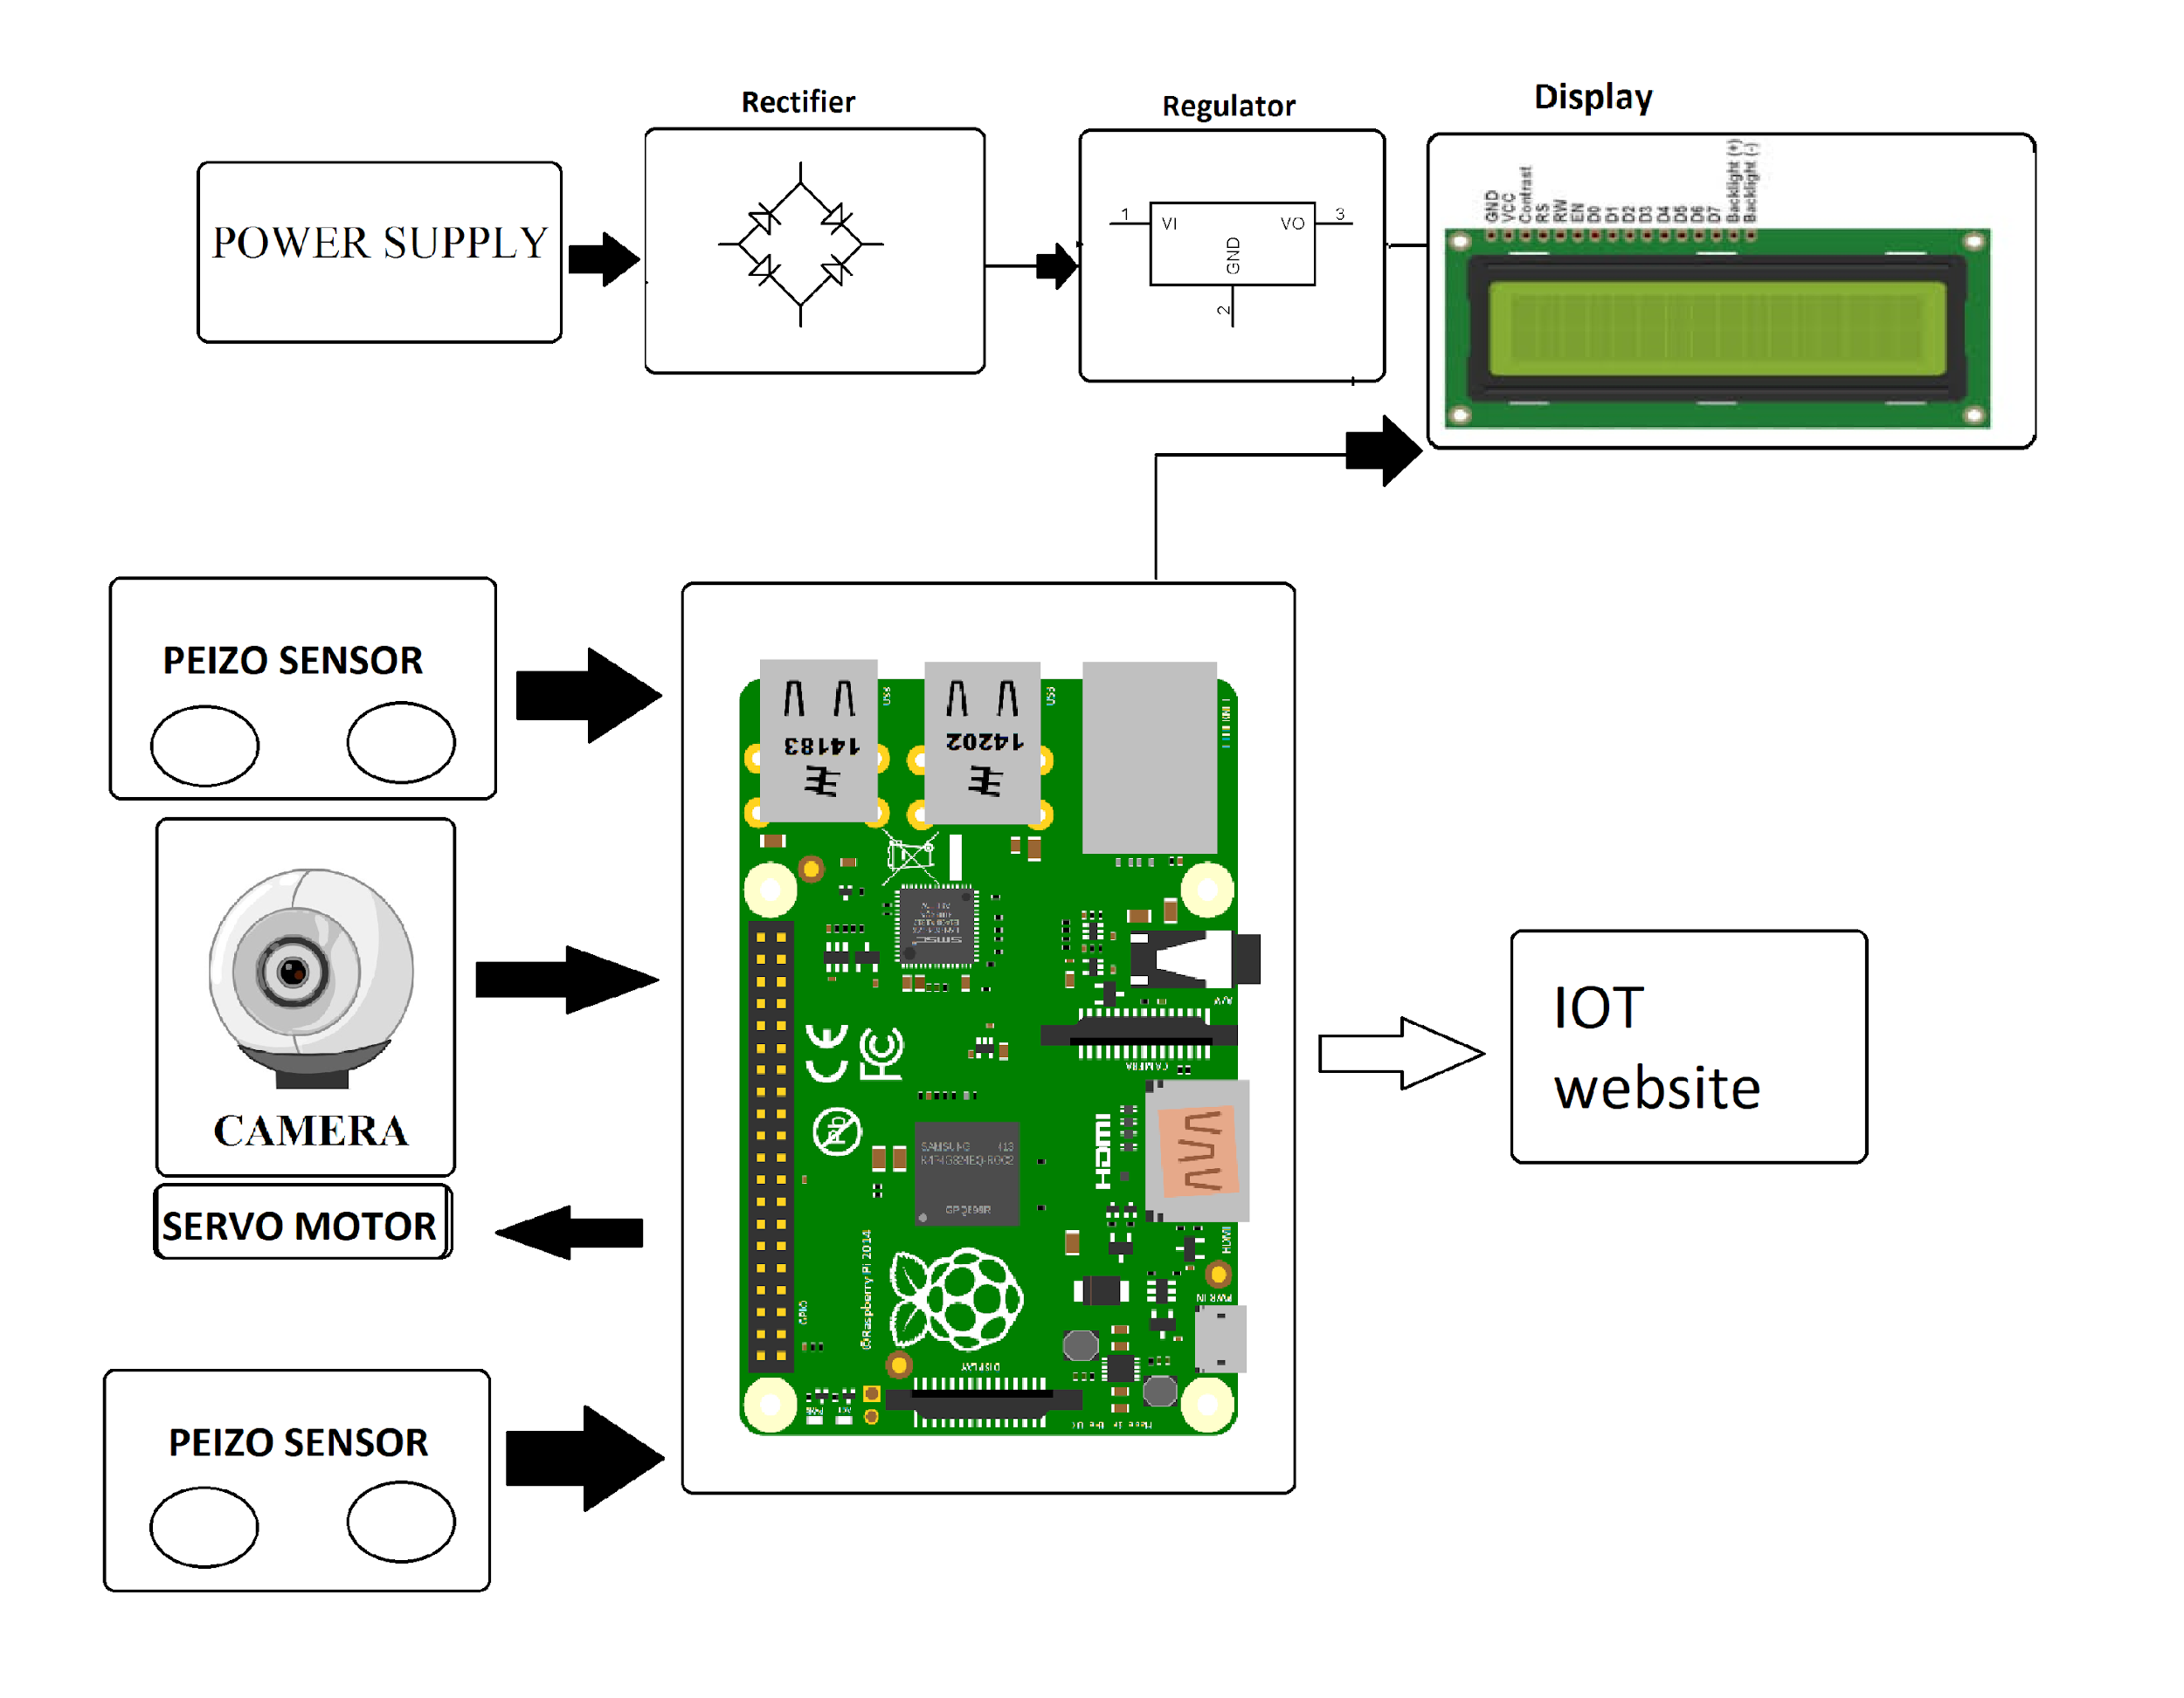
Block Diagram

Slide 6
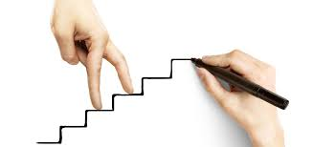
Project Development Stages
Choosing Development Board
Circuit Design
Components Procurement
Soldering
Testing for Connectivity & Issues
PCB Printing
Coding

Slide 7
Choosing Development Board
Step 1: Make a list of required hardware interfaces.
Step 2: Examine the software architecture
Step 3: Select the architecture
Step 4: Identify Memory Needs
Step 5: Start searching for microcontrollers
Step 6: Examine Costs and Power Constraints. ...
Step 7: Check part availability
Step 8: Order the Controller

Slide 8
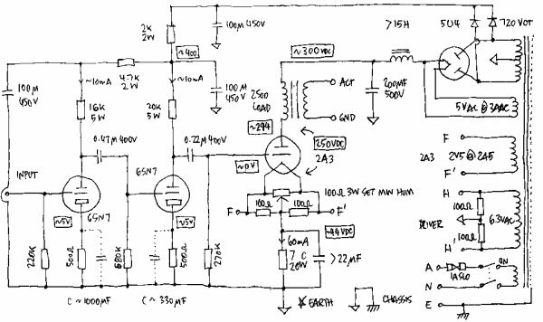
Circuit Design
A circuit is actually any loop through which matter is carried. For an electronic circuit, the matter carried is the charge by electronics and the source of these electrons is the positive terminal of the voltage source .When this charge flows from the positive terminal, through out the loop and reaches the negative terminal, the circuit is said to be completed. However this circuit consists of a number of components which affects the flow of charge in many ways. Some may provide hindrance to the flow of charge, some simple store or dissipate charge. Some require external source of energy, some supply energy.
Circuit Design Tools:
Eagle, Kicad, Proteus
Circuit Digest Capacitor Calculator
NevonExpress Resistor Color Code Calculator

Slide 9
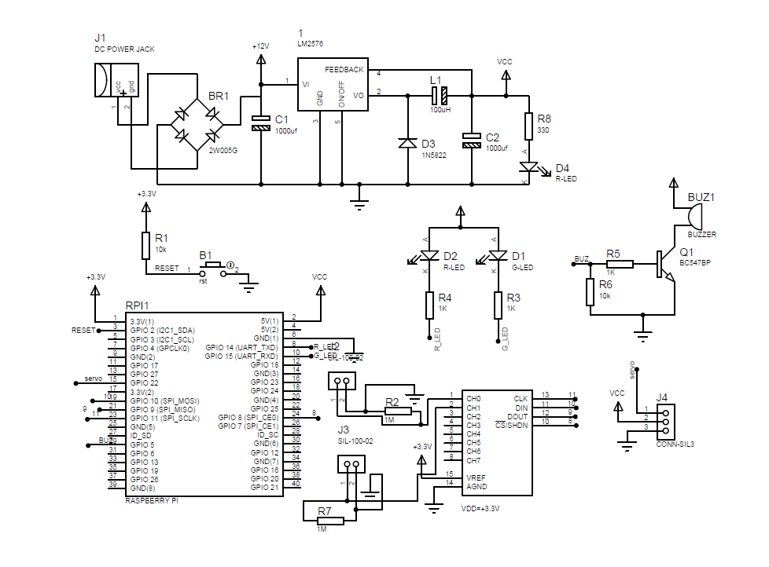

Slide 10
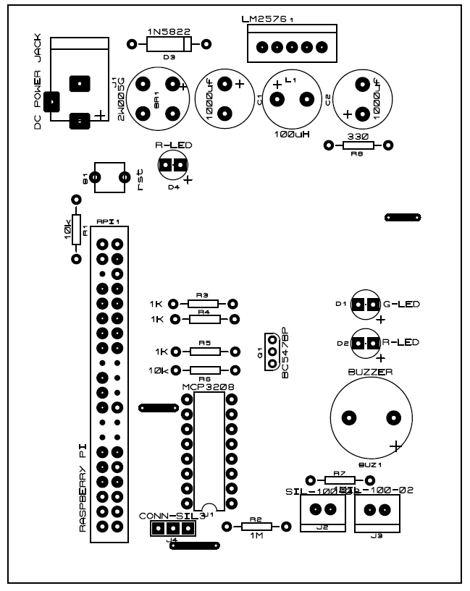

Slide 11
Components Procurement
Component Procurement is a time consuming and difficult task. Components required for project research and development are not easily available in market and local shops.
There are some recent options to procure all required components using easy online using PC or mobile using nevonexpress.com.

Slide 12
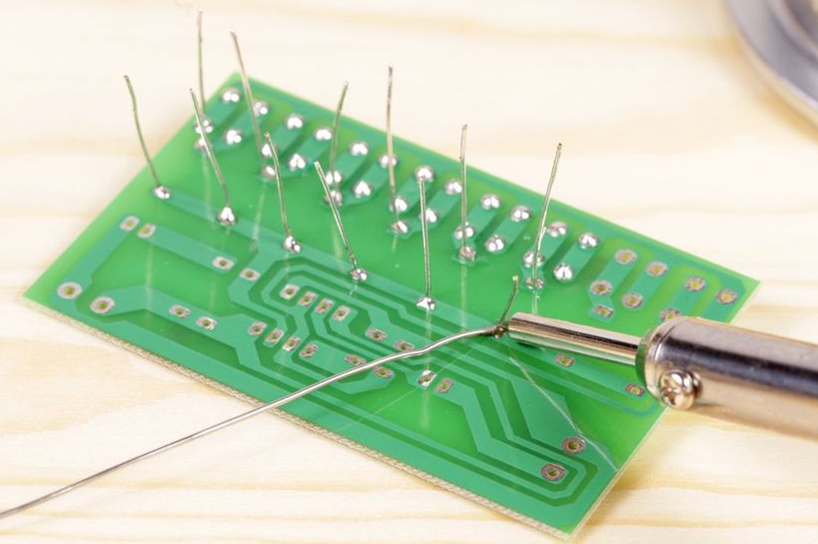
Soldering
With silver soldering, small pieces of solder wire are placed onto the metal prior to heating. A flux, often made of boric acid and denatured alcohol, is used to keep the metal and solder clean and to prevent the solder from moving before it melts.

Slide 13
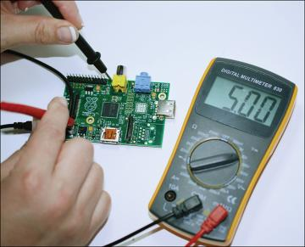
Testing for Connectivity & Issues
Testing Tools:
Multimeter
Power Supply
Oscilloscope

Slide 14
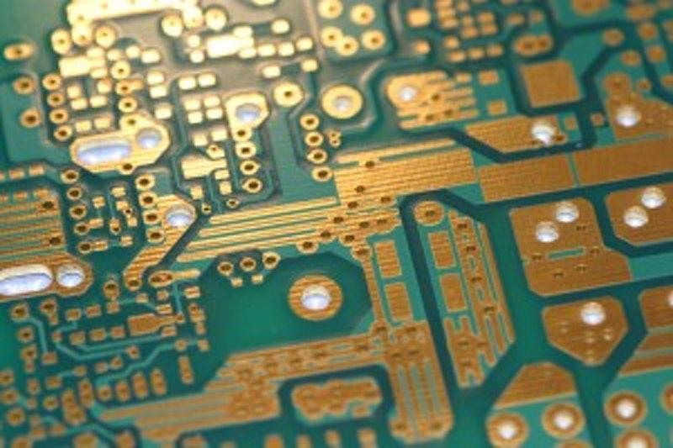
PCB Printing
A printed circuit board mechanically supports and electrically connects electronic components or electrical components using conductive tracks, pads and other features etched from one or more sheet layers of copper laminated onto and/or between sheet layers of a non-conductive substrate.

Slide 15
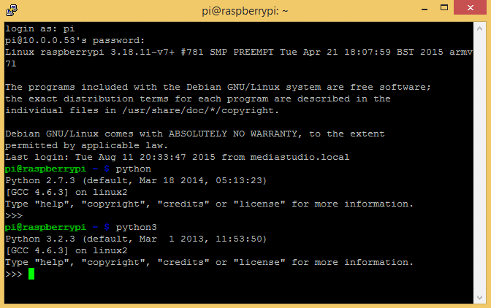
Coding
Python is a beginner-friendly programming language that is used in schools, web development, scientific research, and in many other industries. Python is a wonderful and powerful programming language that's easy to use (easy to read and write) and with Raspberry Pi lets you connect your project to the real world.

Slide 16
HARDWARE REQUIREMENTS
Raspberry Pi 3
DISPLAY
Peizo Sensor
SERVO MOTOR
Camera
SD Card
Resistors
Capacitors
Push Button
Cables & Connectors
Diodes
PCB
LED’s
Adapter/Power Supply

Slide 17
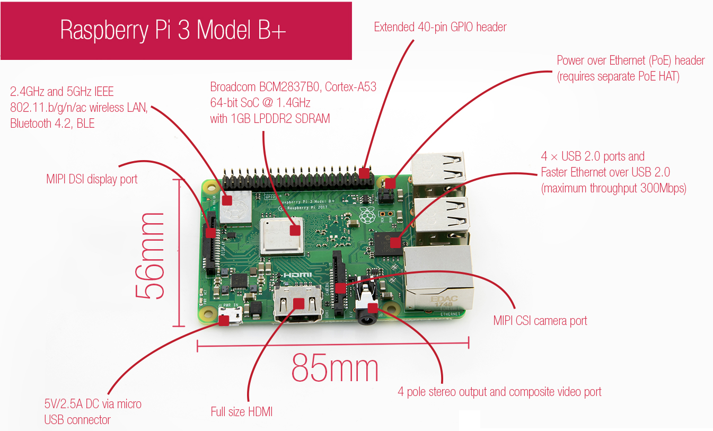

Slide 18

Raspberry Pi is an ARM cortex based popular development board designed for electronics engineers and makers. It’s a single board computer working on low power. With the processing speed and memory, Raspberry Pi can be used for performing different functions at a time
Raspberry Pi 3 model B+ is the latest of the development board from Raspberry Pi. Though it maintains the same mechanical footprint as both its previous versions , yet it is packed with many features. The most recent Raspberry Pi Model B+ has a quicker 64-bit 1.4GHz quad core chip, 1GB of RAM, quicker dual-band 802.11 b/g/n/ac wireless LAN, Bluetooth 4.2, and much quicker 300Mbit/s ethernet.It has Improved thermals on the Pi 3 B+ means that the CPU on the BCM2837 SoC can now run at 1.4GHz, a 17% increase on the previous model.

Slide 19
Features
CPU: Quad-core 64-bit ARM Cortex A53 clocked at 1.2 GHz
GPU: 400MHz VideoCore IV multimedia
Memory: 1GB LPDDR2-900 SDRAM (i.e. 900MHz)
USB ports: 4
Video outputs: HDMI, composite video (PAL and NTSC) via 3.5 mm jack
Network: 10/100Mbps Ethernet and 802.11n Wireless LAN
Peripherals: 17 GPIO plus specific functions, and HAT ID bus
Bluetooth: 4.1
Power source: 5 V via MicroUSB or GPIO header
Size: 85.60mm × 56.5mm

Slide 20

Software Requirements
Python is one of the most popular languages in the world and has been around for more than two decades.
It is heavily used in academic environments and is a widely supported platform in modern applications, especially utilities, and desktop and Web applications. Python is highly recommended as a language that is easy for newcomers to program. With its easy-to-read syntax, the introduction is gentle and the overall experience much better for a newbie.

Slide 21

Operating System
Raspbian is a free operating system based on Debian optimized for the Raspberry Pi hardware. An operating system is the set of basic programs and utilities that make your Raspberry Pi run.
However, Raspbian provides more than a pure OS: it comes with over 35,000 packages, pre-compiled software bundled in a nice format for easy installation on your Raspberry Pi.
The main reason why Raspbian is extremely popular is that it has thousands of pre built libraries to perform many tasks and optimize the OS. This forms a huge advantage while building applications.

Slide 22
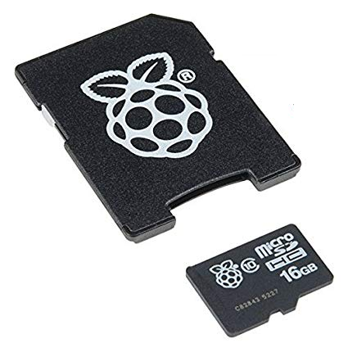
SD Card
Raspberry Pi has no storage space on board
SD/micro SD card stores the OS.
The total memory of the SD card is about 16 GB
Class 10 is preferred owing to its high speed

Slide 23
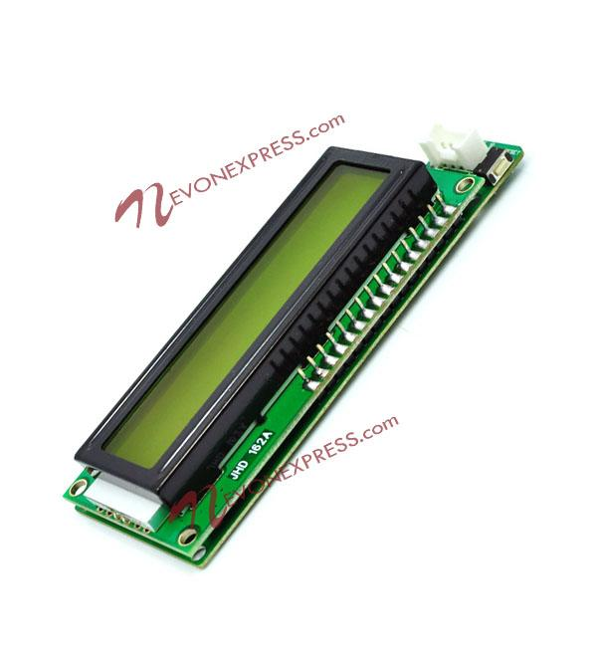
LCD Display
An LCD is an electronic display module which uses liquid crystal to produce a visible image. The 16×2 /20x4 LCD display is a very basic module commonly used in DIYs and circuits. In this LCD each character is displayed in pixel matrix. The command register stores the control directions given to the LCD. A command is an instruction given to LCD to perform a predefined task like initializing it, clearing its display, placing the cursor position, controlling screen etc. The data register stores the data to be displayed on the LCD. The information is the ASCII value of this character to be shown on the LCD.

Slide 24
Features
Operating Voltage is 4.7V to 5.3V
Current consumption is 1mA without backlight
Alphanumeric LCD display module, meaning can display alphabets and numbers
Consists of two rows and each row can print 16 characters.
Each character is build by a 5✕8 pixel box
Can work on both 8-bit and 4-bit mode
It can also display any custom generated characters
Available in Green and Blue Backlight

Slide 25
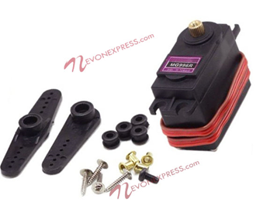
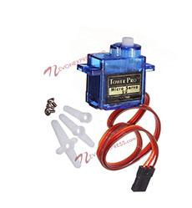
Servo Motor
Servo motors have been around for a long time and are utilized in many applications. They are small in size but pack a big punch and are very energy-efficient. These features allow them to be used to operate remote-controlled or radio-controlled toy cars, robots and airplanes. Servo motors are also used in industrial applications, robotics, in-line manufacturing, pharmaceutics and food services.

Slide 26
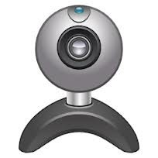
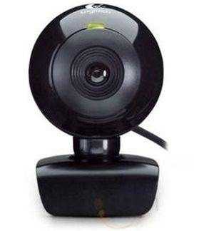
CAMERA
A webcam is a video camera that feeds or streams its image in real time to or through a computer to a computer network. When "captured" by the computer, the video stream may be saved, viewed or sent on to other networks travelling through systems such as the internet, and e-mailed as an attachment. When sent to a remote location, the video stream may be saved, viewed or on sent there.

Slide 27
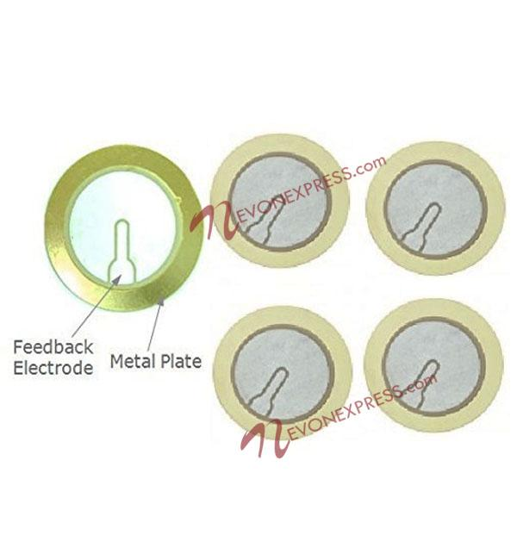
Piezoelectric Sensor
These piezoelectric sensors convert Mechanical Force Into Electrical Output These Are Perfect For Using As Touch-Sensors, Electronic Drum Triggers, Buzzers, Or Making Your Own Contact Mics, security systems, door knock detections and DIY projects They Can Also Be Used For Custom Pickup Arrangements In More Traditional Stringed And Percussion Instruments.
Thickness | 2mm
Diameter | 27mm
Output Power | 1.5V
Package Weight | 90 grams
Material | PZT
No of Pieces | 1

Slide 28
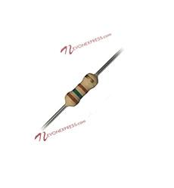
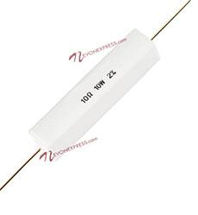
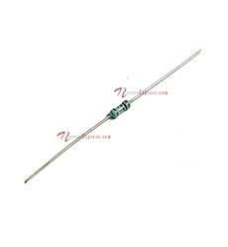
Resistors
The resistor is a passive electrical component to create resistance in the flow of electric current. In almost all electrical networks and electronic circuits they can be found. The resistance is measured in ohms. An ohm is the resistance that occurs when a current of one ampere passes through a resistor with a one volt drop across its terminals. The current is proportional to the voltage across the terminal ends. This ratio is represented by Ohm’s law:
formula with ohm's law: R=V/I
Resistors are used for many purposes. A few examples include delimit electric current, voltage division, heat generation, matching and loading circuits, control gain, and fix time constants. They are commercially available with resistance values over a range of more than nine orders of magnitude. They can be used to as electric brakes to dissipate kinetic energy from trains, or be smaller than a square millimeter for electronics.

Slide 29
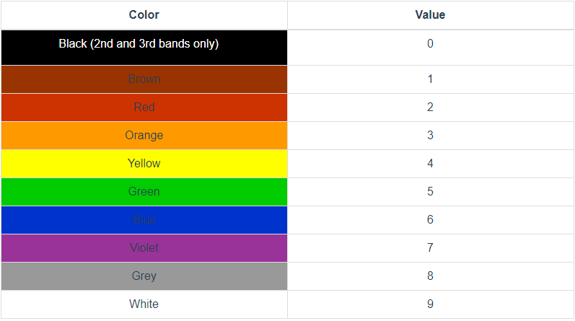
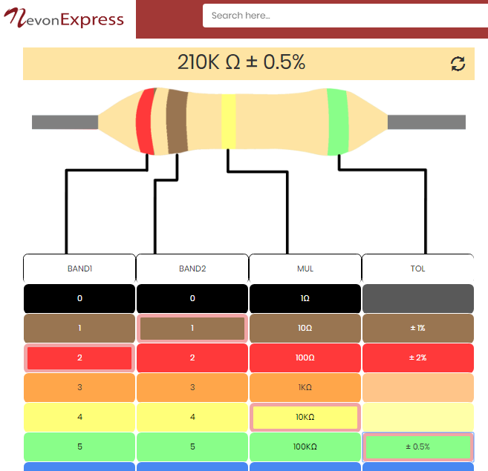
Resistors Code Calculation
Resistor Calculations requires color code charts for resistor value calculations.
For fast and efficient calculations of resistors color codes from values or vice versa we can use free online tool available at nevonexpress.com > resistor color code calculator

Slide 30
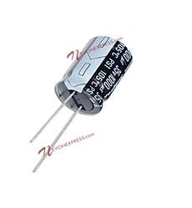
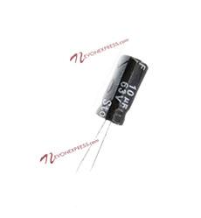
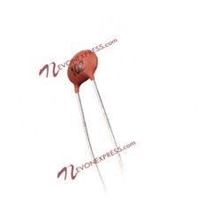
Capacitors
The capacitor is a component which has the ability or “capacity” to store energy in the form of an electrical charge producing a potential difference (Static Voltage) across its plates, much like a small rechargeable battery.
There are many different kinds of capacitors available from very small capacitor beads used in resonance circuits to large power factor correction capacitors, but they all do the same thing, they store charge.
In its basic form, a capacitor consists of two or more parallel conductive (metal) plates which are not connected or touching each other, but are electrically separated either by air or by some form of a good insulating material such as waxed paper, mica, ceramic, plastic or some form of a liquid gel as used in electrolytic capacitors. The insulating layer between a capacitors plates is commonly called the Dielectric.
Due to this insulating layer, DC current can not flow through the capacitor as it blocks it allowing instead a voltage to be present across the plates in the form of an electrical charge.
The conductive metal plates of a capacitor can be either square, circular or rectangular, or they can be of a cylindrical or spherical shape with the general shape, size and construction of a parallel plate capacitor depending on its application and voltage rating.

Slide 31
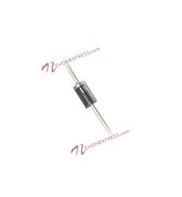
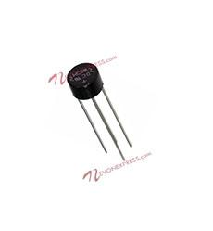
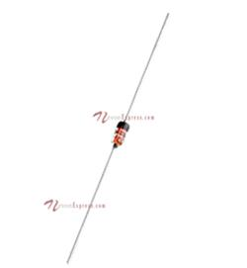
Diodes
A diode is a two-terminal electronic component that conducts current primarily in one direction (asymmetric conductance); it has low (ideally zero) resistance in one direction, and high (ideally infinite) resistance in the other. A diode vacuum tube or thermionic diode is a vacuum tube with two electrodes, a heated cathode and a plate, in which electrons can flow in only one direction, from cathode to plate. A semiconductor diode, the most common type today, is a crystalline piece of semiconductor material with a p–n junction connected to two electrical terminals.[5] Semiconductor diodes were the first semiconductor electronic devices. The discovery of asymmetric electrical conduction across the contact between a crystalline mineral and a metal was made by German physicist Ferdinand Braun in 1874. Today, most diodes are made of silicon, but other materials such as gallium arsenide and germanium are used.
The most common function of a diode is to allow an electric current to pass in one direction (called the diode's forward direction), while blocking it in the opposite direction (the reverse direction). As such, the diode can be viewed as an electronic version of a check valve.

Slide 32
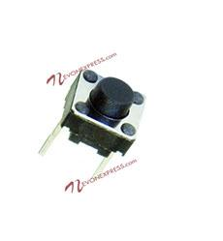
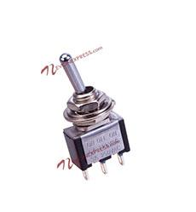
Buttons & Switches
A push-button (also spelled pushbutton) or simply button is a simple switch mechanism for controlling some aspect of a machine or a process. Buttons are typically made out of hard material, usually plastic or metal.[1] The surface is usually flat or shaped to accommodate the human finger or hand, so as to be easily depressed or pushed. Buttons are most often biased switches, although many un-biased buttons (due to their physical nature) still require a spring to return to their un-pushed state. Terms for the "pushing" of a button include pressing, depressing, mashing, slapping, hitting, and punching.

Slide 33
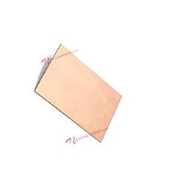
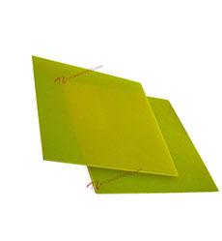
PCB – Printed Circuit Board
A printed circuit board (PCB) mechanically supports and electrically connects electronic components or electrical components using conductive tracks, pads and other features etched from one or more sheet layers of copper laminated onto and/or between sheet layers of a non-conductive substrate. Components are generally soldered onto the PCB to both electrically connect and mechanically fasten them to it.
Printed circuit boards are used in all but the simplest electronic products. They are also used in some electrical products, such as passive switch boxes.
Alternatives to PCBs include wire wrap and point-to-point construction, both once popular but now rarely used. PCBs require additional design effort to lay out the circuit, but manufacturing and assembly can be automated. Specialized CAD software is available to do much of the work of layout. Mass-producing circuits with PCBs is cheaper and faster than with other wiring methods, as components are mounted and wired in one operation. Large numbers of PCBs can be fabricated at the same time, and the layout only has to be done once. PCBs can also be made manually in small quantities, with reduced benefits.

Slide 34
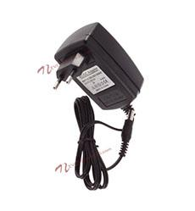
Power Supply
An AC adapter, AC/DC adapter, or AC/DC converter is a type of external power supply, often enclosed in a case similar to an AC plug. Other common names include plug pack, plug-in adapter, adapter block, domestic mains adapter, line power adapter, wall wart, power brick, and power adapter.

Slide 35
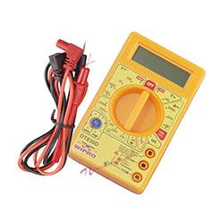
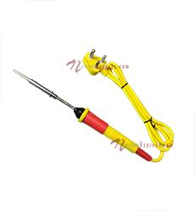
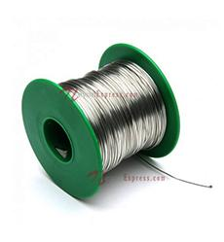
Tools Needed
Multimeter is needed for testing of electronics pcb based projects for voltage, connectivity and other issues.
Soldering iron is used along with soldering accessories to ensure proper connectivity between components and the pcb surface and ensure proper working of the system.

Slide 36
THANK YOU

